Slide 1


Presentation for Parents

Slide 2


What is
Safer Internet Day?
Safer Internet Day is celebrated across the globe in over 170 countries, with thousands of children joining in across the UK. It’s a day when we celebrate all the great things about being online and teach children about how to stay safe online. As a school, we decided to plan online safety lessons as part of the children’s computing lessons this week.
The theme for Safer Internet Day this year is ‘Want to talk about it?’ With a focus on making space for conversations about life online.

Slide 3


















What can families and children do online?
There are so many things families and children can do online, and the internet can help to make things easier. Families and children might…
use the internet to chat, or video call family and friends
watch TV shows, sports, movies, or listen to music online
find out about what’s happening in the news online
use the internet to find out new things
share photos, or videos online
play games online

Slide 4





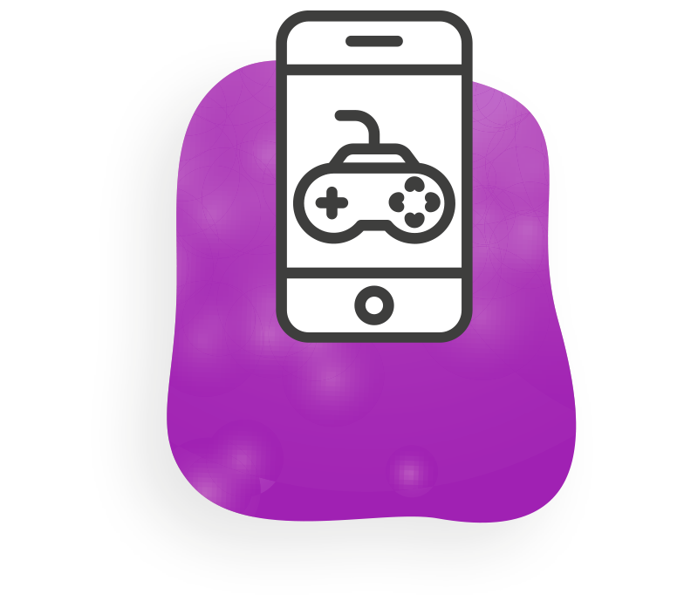


Families and children will often use a range of devices to play games…
Phone
Computer
Console
Tablet
Laptop
Parents are advised to supervise children when they are accessing online materials and resources, including playing online games.
This means being in the same room as them when they are accessing devices, setting boundaries, setting parental controls and knowing what they are accessing online.

Slide 6









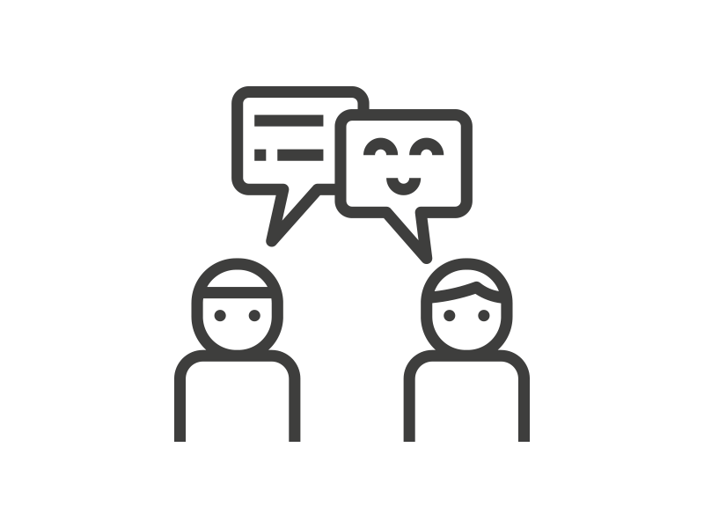



Practical tips for starting conversations about life online
Notes:
Great answers everyone. Being respectful online means…
Read out slide on how to be respectful online.

Slide 7
Start a conversation with your child
On the next few pages, you will find further top tips for parents
1. Having conversations without judgement.
Whether by playing games, watching videos, or doing things your child enjoys, spending time together online is a great way to start conversations about the online world and how they’re finding being a part of it. It is important to ask questions and take an interest in what your child enjoys online.An essential part of having this open dialogue is to not judge, even if their behaviour or life online isn’t what you wanted or expected. This ensures that your child feels they can come to you if ever they make a mistake or experience a problem online.
2. Knowing where you can learn more about their favourite apps and games.
When your child starts talking about a new game or app, why not do some research into the reporting and blocking options available? Then you can help your child if they come to you with an issue.

Slide 8
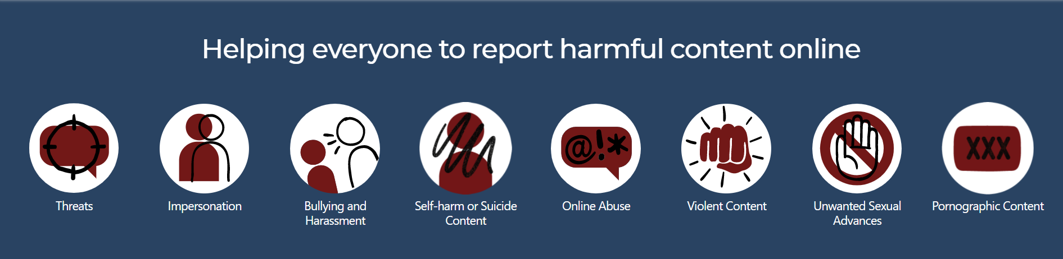
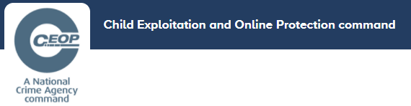
Start a conversation with your child
Getting support if things go wrong.
There are lots of organisations who are there to support you and your family if something has gone wrong. The Report Harmful Content website can help you with issues such as cyberbullying, impersonation and threats. You can report worrying behaviour towards children to CEOP. Find out more on Childnet’s Get Help page.
Reassuring your child that whatever happens online, you are there to support them.
Let your child know that the best way to address any problem they have online, is to tell a trusted adult immediately. For example, this might include someone sending them a friend request; an online message; telling them to visit a specific website, or app; or asking them for their personal information. Reassure them that if anything happens online that they are unsure about, or makes them feel worried or upset, they can come to you for help.

Slide 9



Take a screenshot
If you suspect, or find out from someone else that your child is dealing with a worrying situation online there are other things children (and parents) can do too…
Block
Report
Notes:
We know that sadly not everyone online is respectful all the time. If someone is being disrespectful online, here are some things you can do.
Read strategies from the slide.

Slide 10
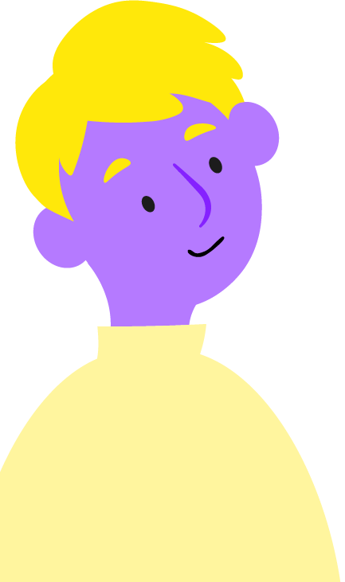

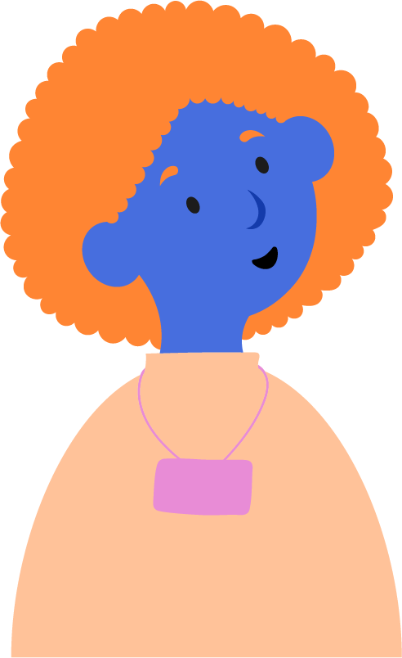
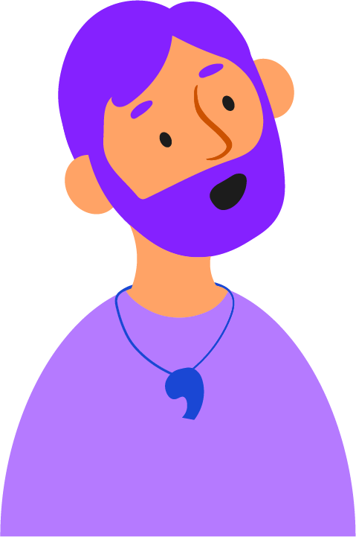
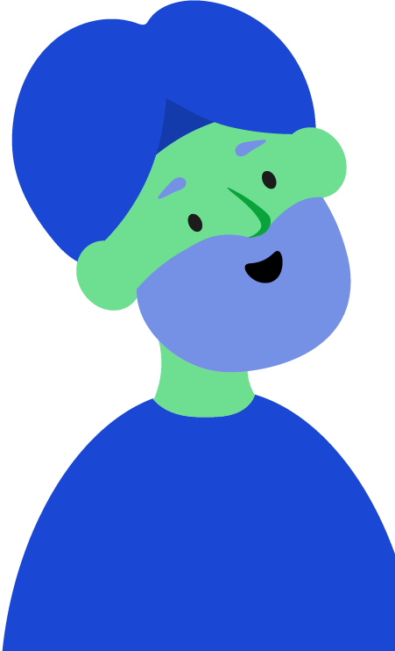

Who can children talk to?
Notes:
We know that sadly not everyone online is respectful all the time. If someone is being disrespectful online, here are some things you can do.
Read strategies from the slide.

Slide 11






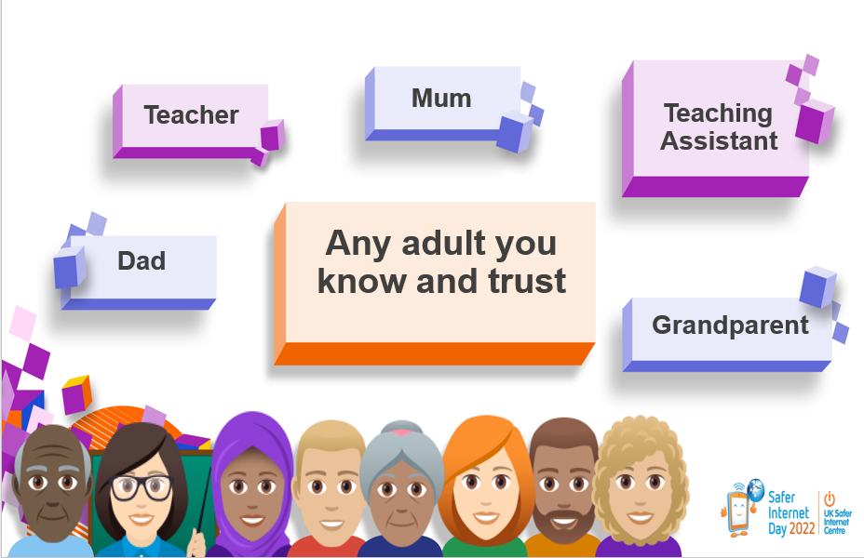
Parents can teach their child that if anything online makes them feel…
Upset
Scared
Curious
Angry
Worried
Confused
…they should talk to a trusted adult
for help and support
Notes:
But remember if anything at all online makes you feel upset, scared, angry, worried or confused… can anyone tell me, what’s the most important thing to do?
Take answers until a learner says ‘tell someone/an adult’ then move on.

Slide 12



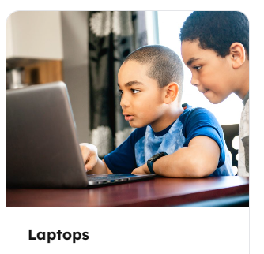
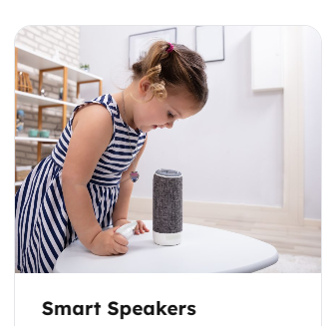
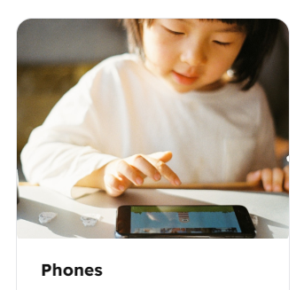
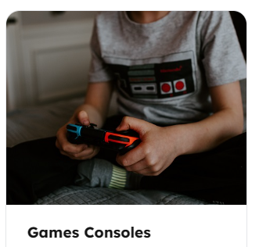
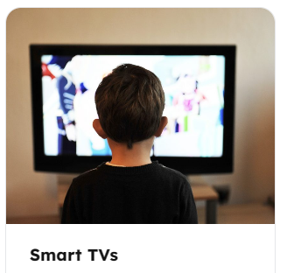
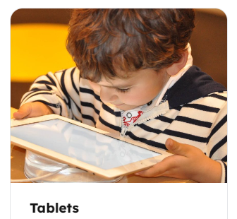
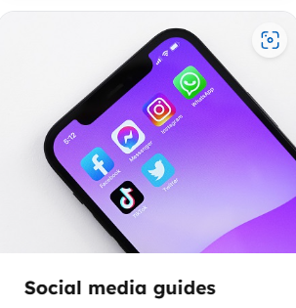

Slide 13
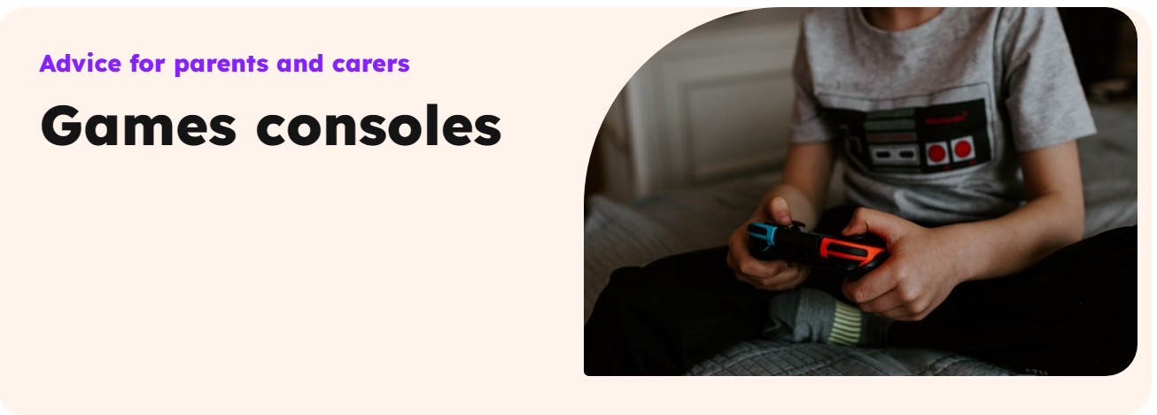





Slide 14
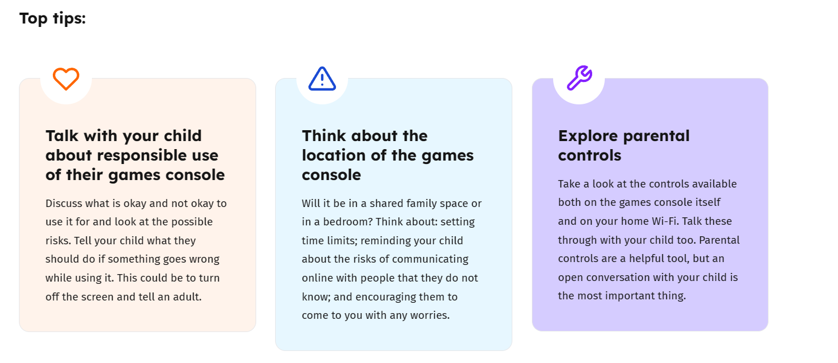

Slide 15
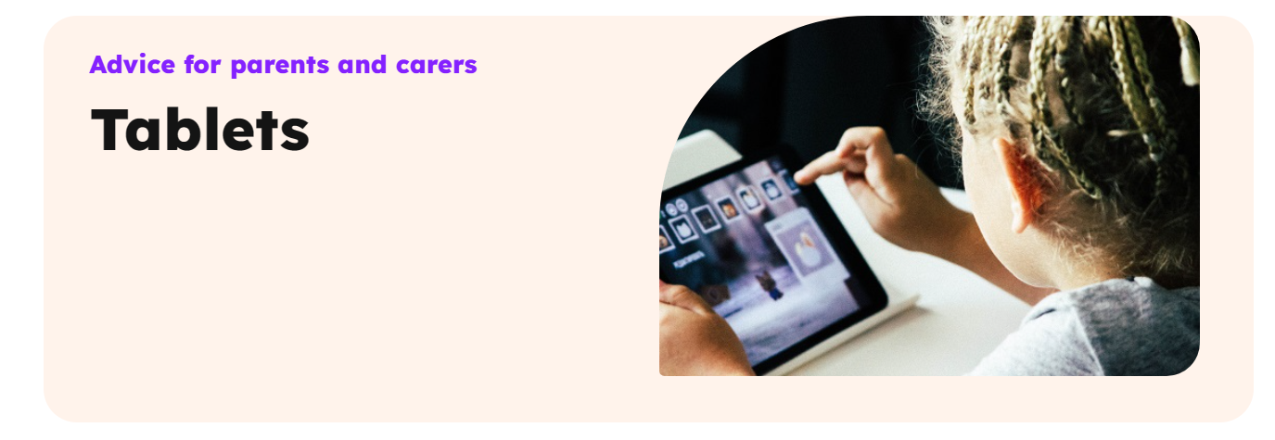




Slide 16
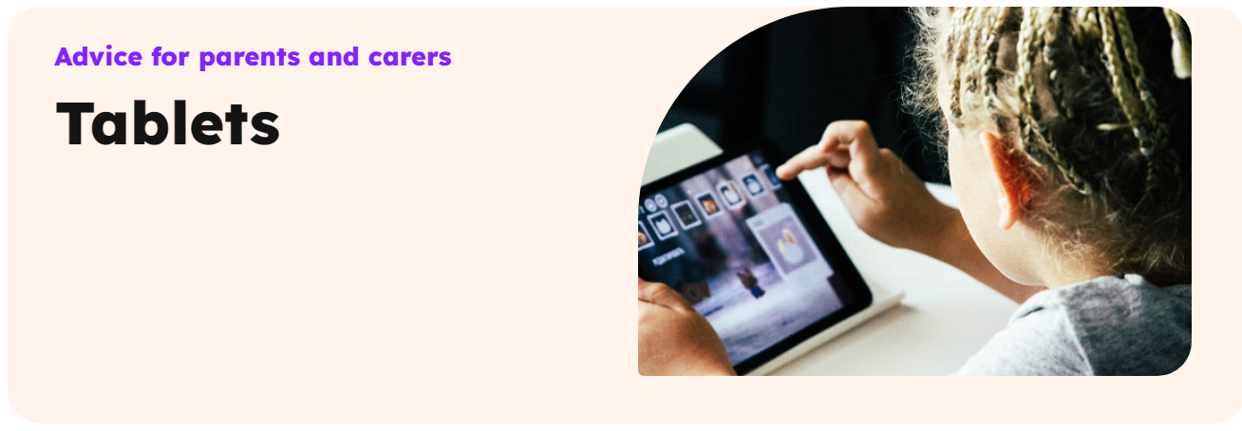
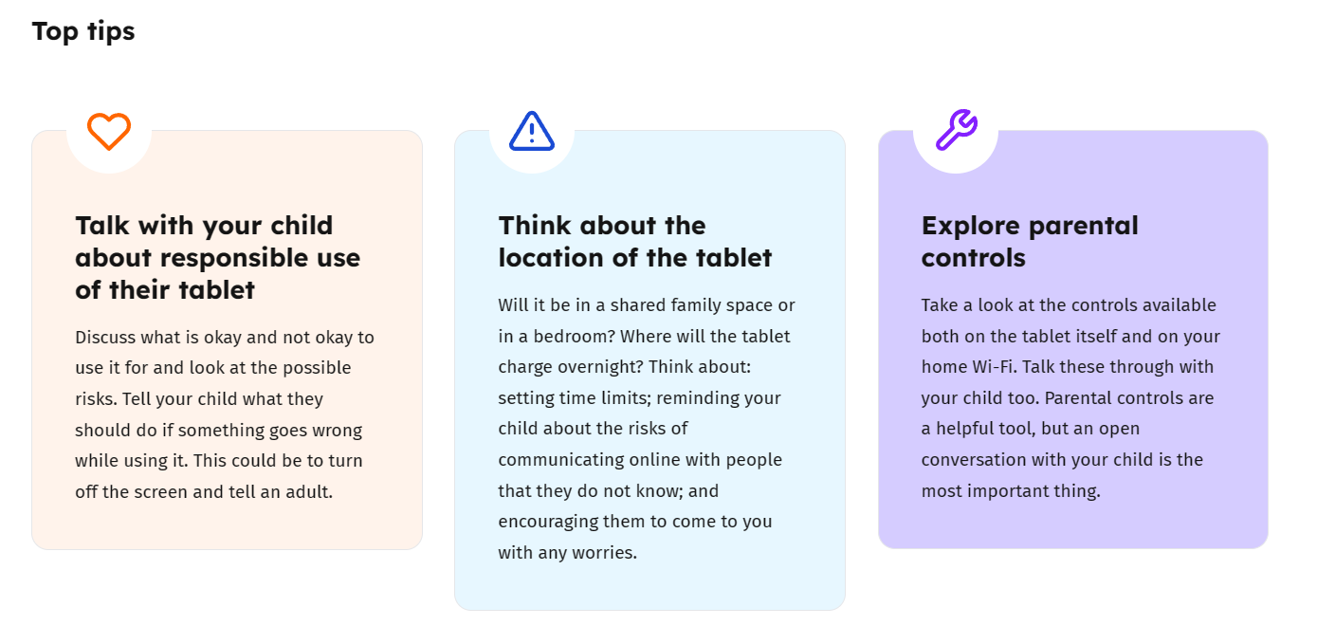

Slide 17

Start a conversation with your child

Slide 18

Start a conversation with your child
Start a conversation video link

Slide 19

5 Internet Safety Tips for Kids
https://safeshare.tv/x/ss5e3c0e6d20479
Notes:
Alternative video link: https://www.youtube.com/watch?v=X9Htg8V3eik

Slide 20
Any questions?
We hope that this presentation has been useful and supportive.
Further resources and information can be found on the online safety page of our website.
We are also available to support and signpost, please just email your child’s class teacher, email or call the office, or speak to a member of SLT on the gate.

