Slide 1
Guidance for teachers
We have provided possible slides that you may wish to use when holding a workshop for parents of children who will be starting school in September.
Please do edit these slides as you see fit to make them the most suitable for your school and how you teach maths in your setting.
Please feel free to hide or change any slides that are not relevant to your school.
There are a couple of slides towards the end that will inform parents about what the EEF Reception Maths Jigsaw Trial is and what it involves.

Slide 2
Reception Maths
Parent workshop
Name

Slide 3

The maths curriculum should allow children to …
develop a strong grounding in number
develop a deep understanding of the numbers to 10
understand the relationships between numbers
understand the patterns within numbers
Develop spatial reasoning skills, including within shape, space and measures.

Slide 4
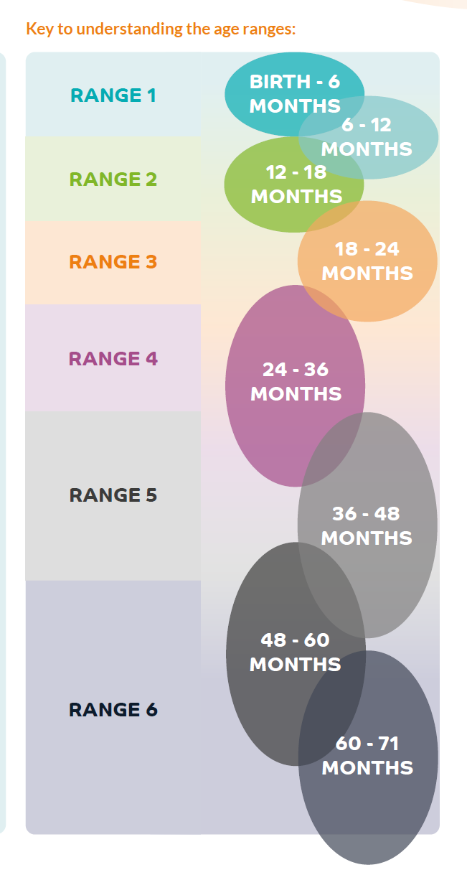

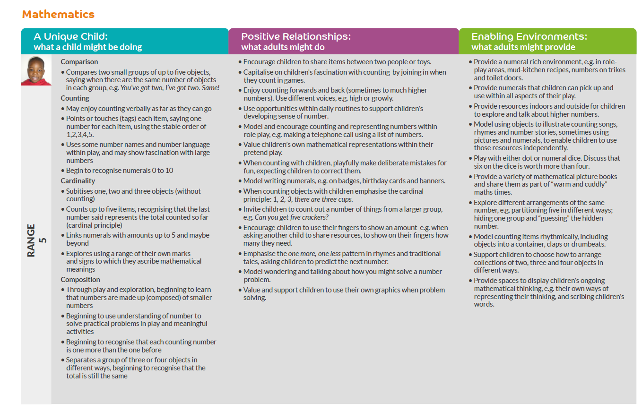
Birth to 5 matters

Slide 5
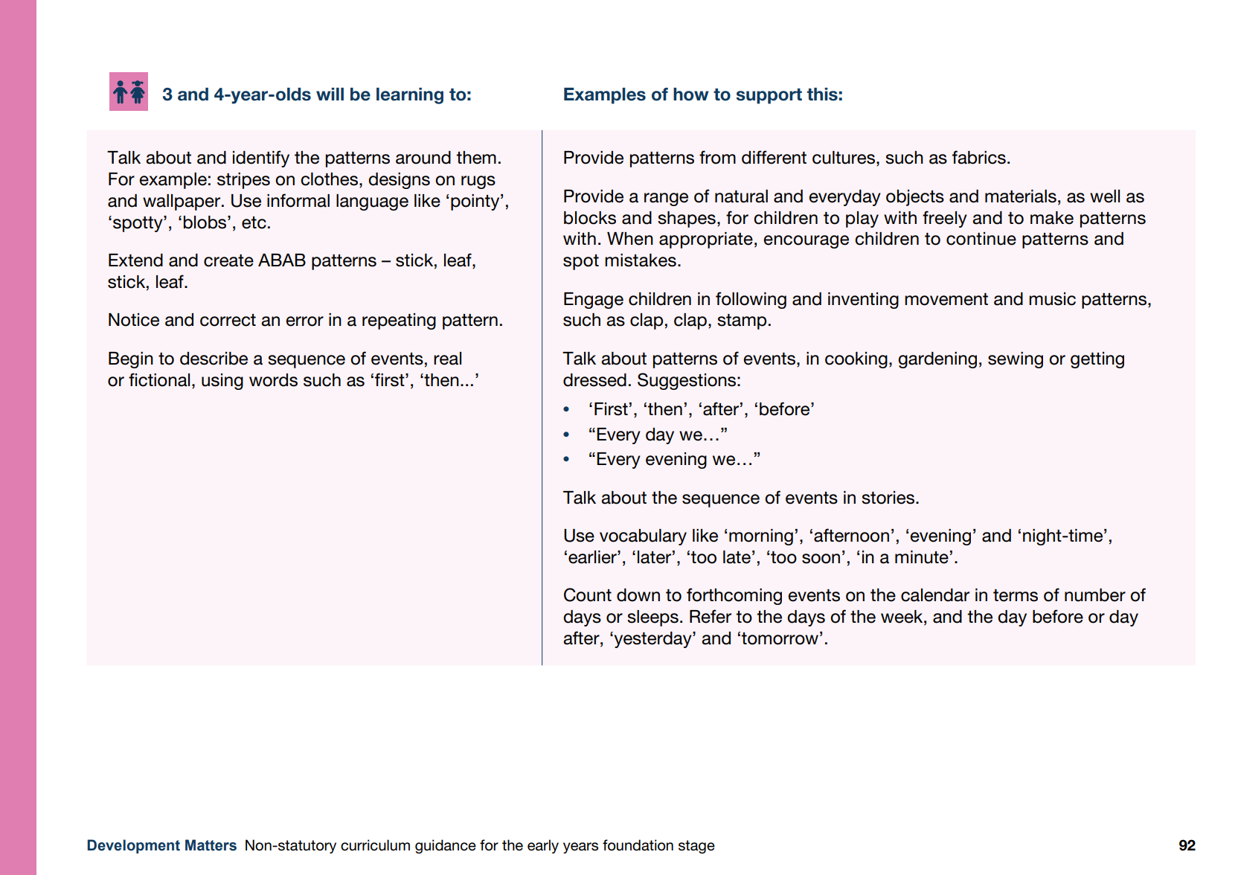

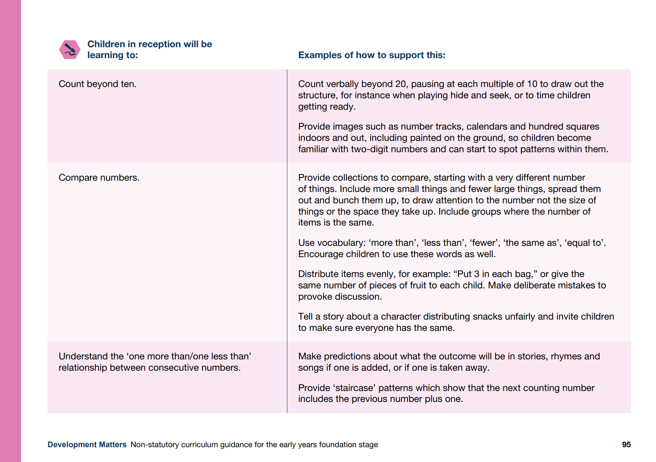
Development matters

Slide 6
Finding how many

Slide 7

Subitising is “instantly seeing how many”, taken from a Latin word meaning suddenly.
Subitising
Counting
“Counting is a precise, step-by-step procedure governed by rules…children have to coordinate all of these rules at the same time into one set of actions.”
Erikson (2024)
1.
One-to-one principle
2.
Stable order principle
3.
Cardinal principle
Clements (1999)
Gelman & Gallistel (1978)

Slide 8
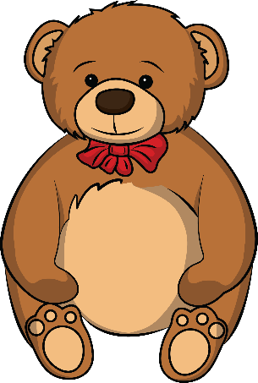



Subitising

Slide 9
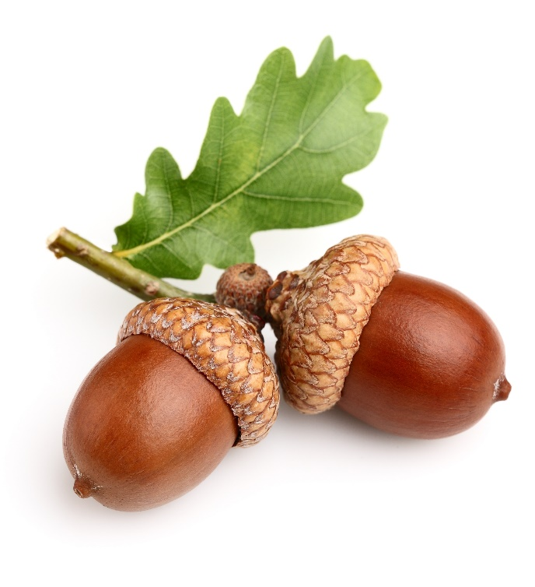
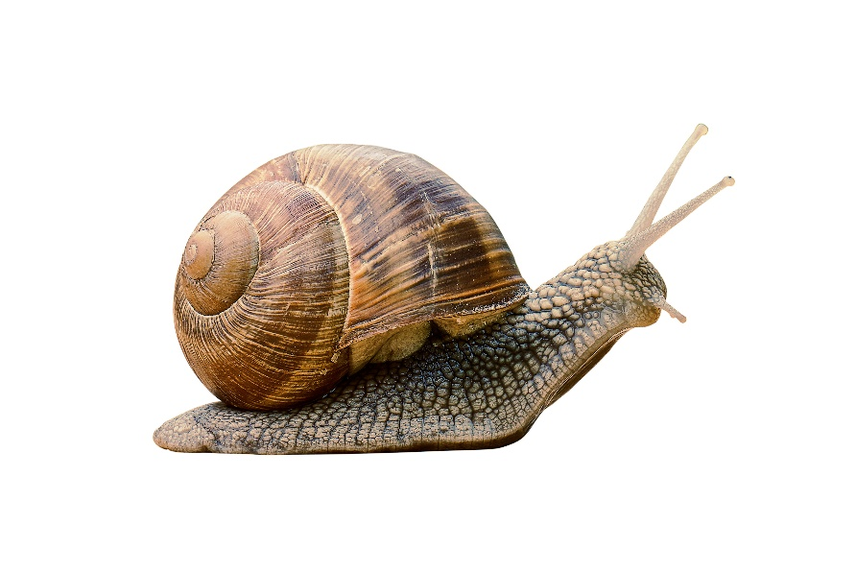

Subitising

Slide 10
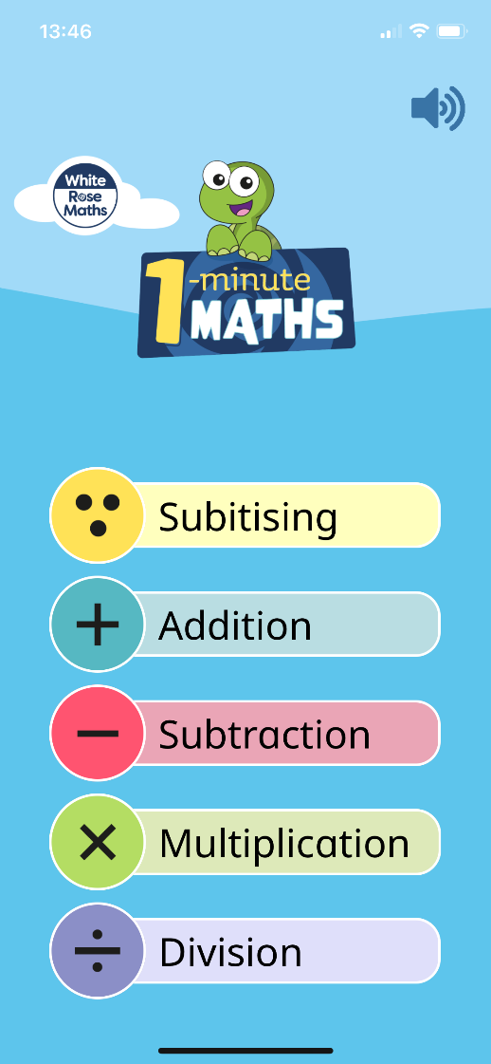
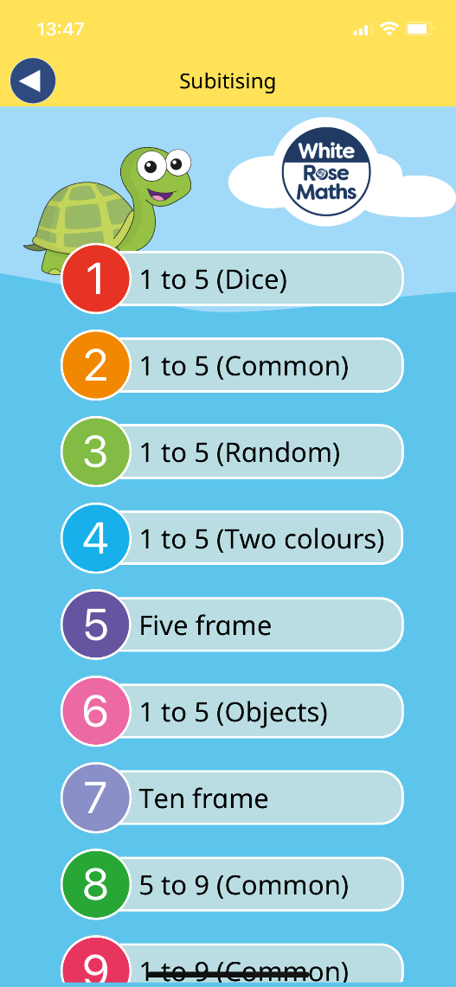
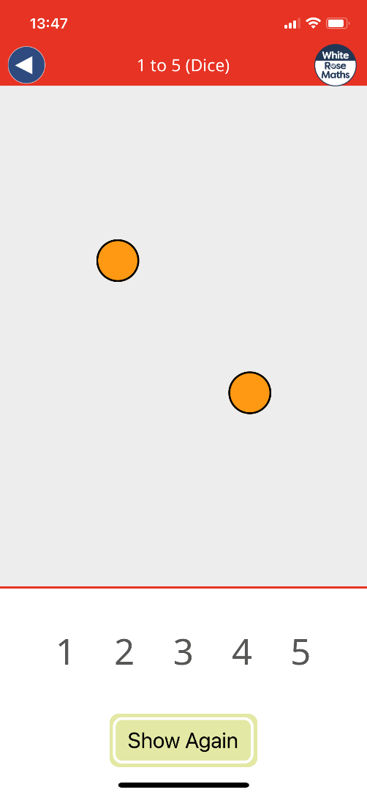
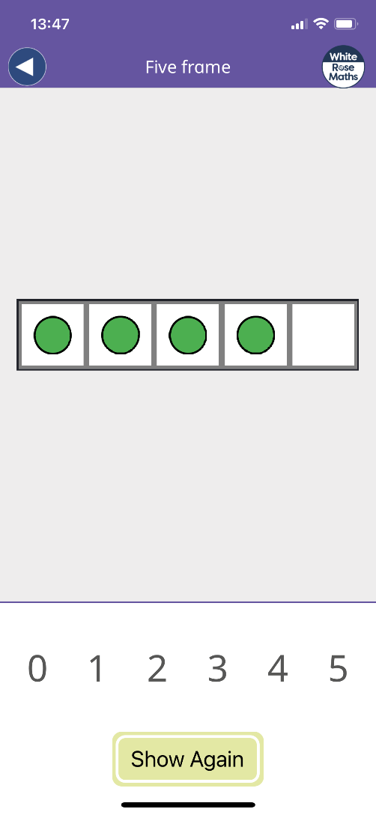
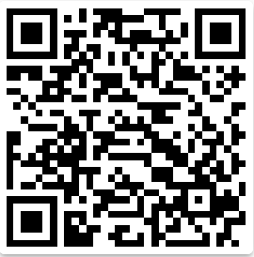

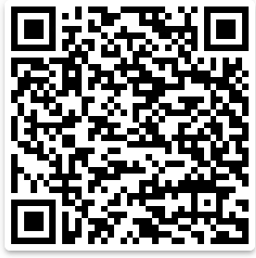

White Rose 1-minute maths

Slide 11


The one to one principle
Counting each item once and only once
1
2
3
4
5

Slide 12
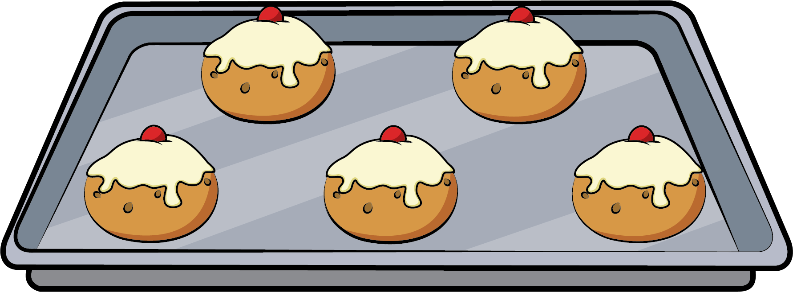


The stable order principle
Learning the sequence of number names
2
3
4
1
5

Slide 13


The cardinal principle
The last object counted gives the total quantity

Slide 14







The cardinal principle
The last object counted gives the total quantity
There are six apples.

Slide 15
What maths looks like in EYFS

Slide 16
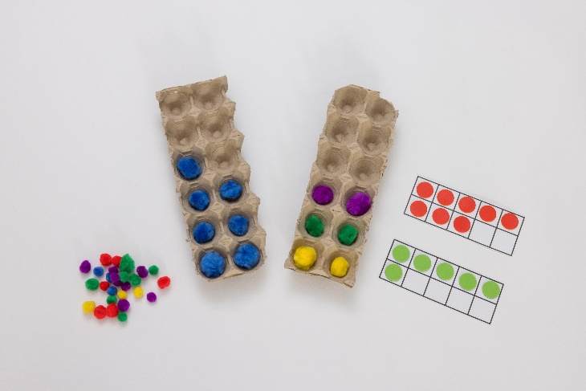
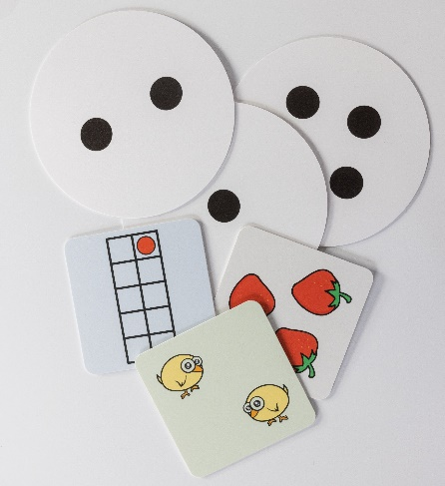
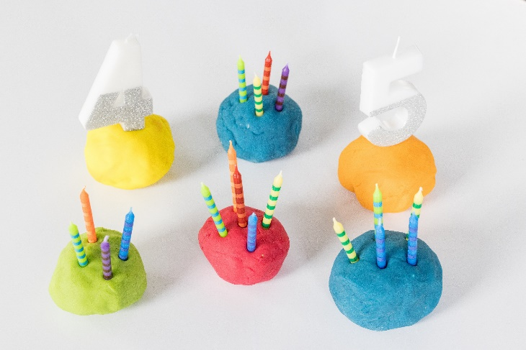
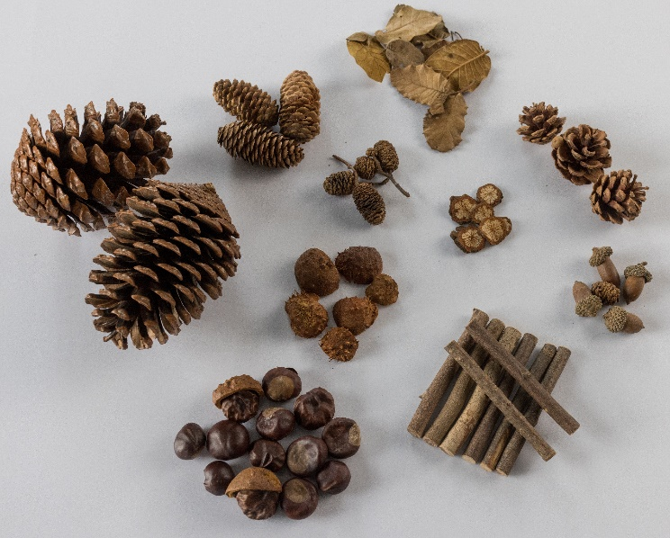
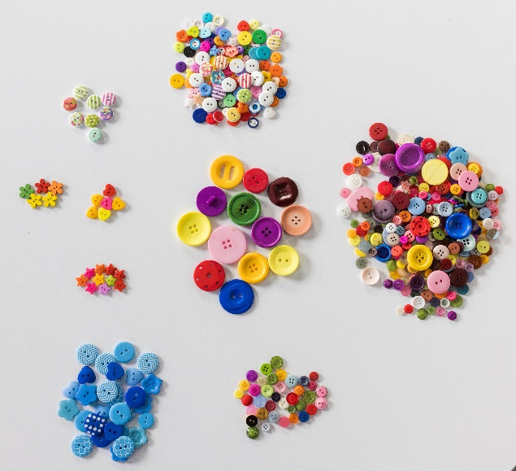
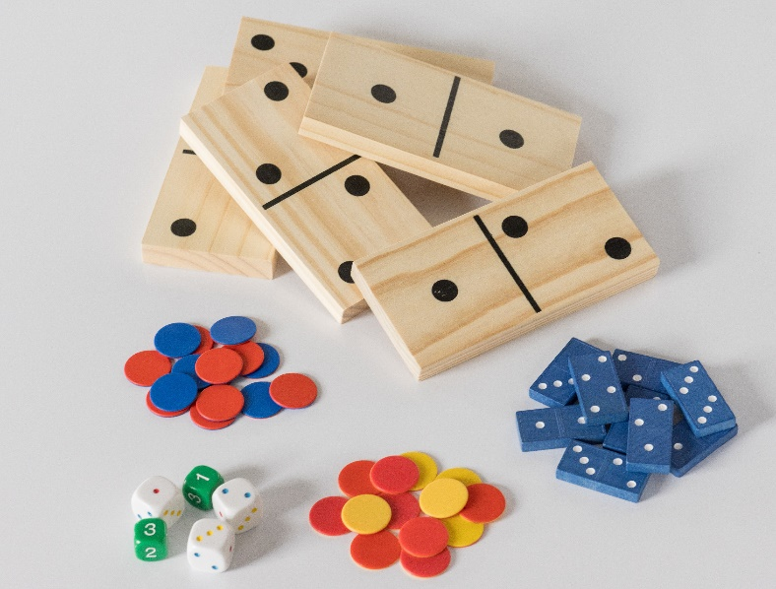
Concrete resources

Slide 17




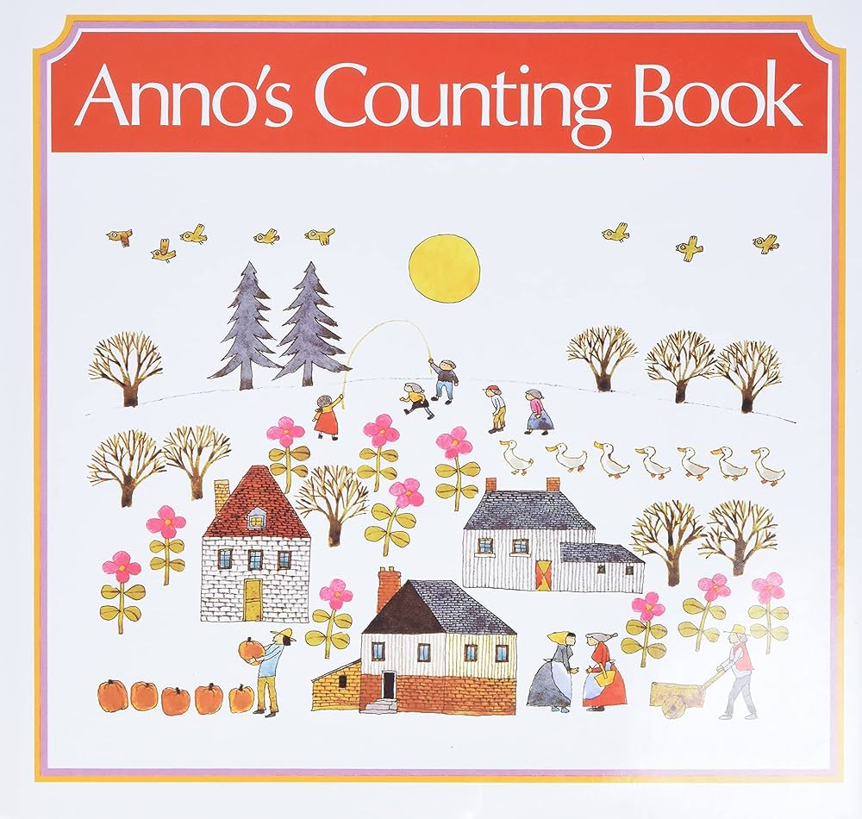
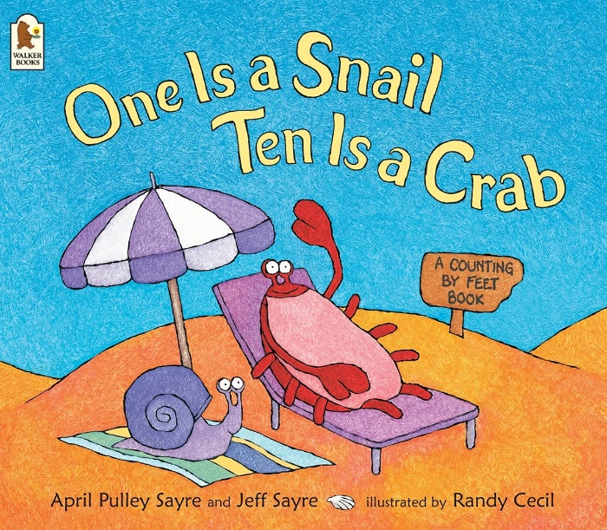

Maths through stories

Slide 18

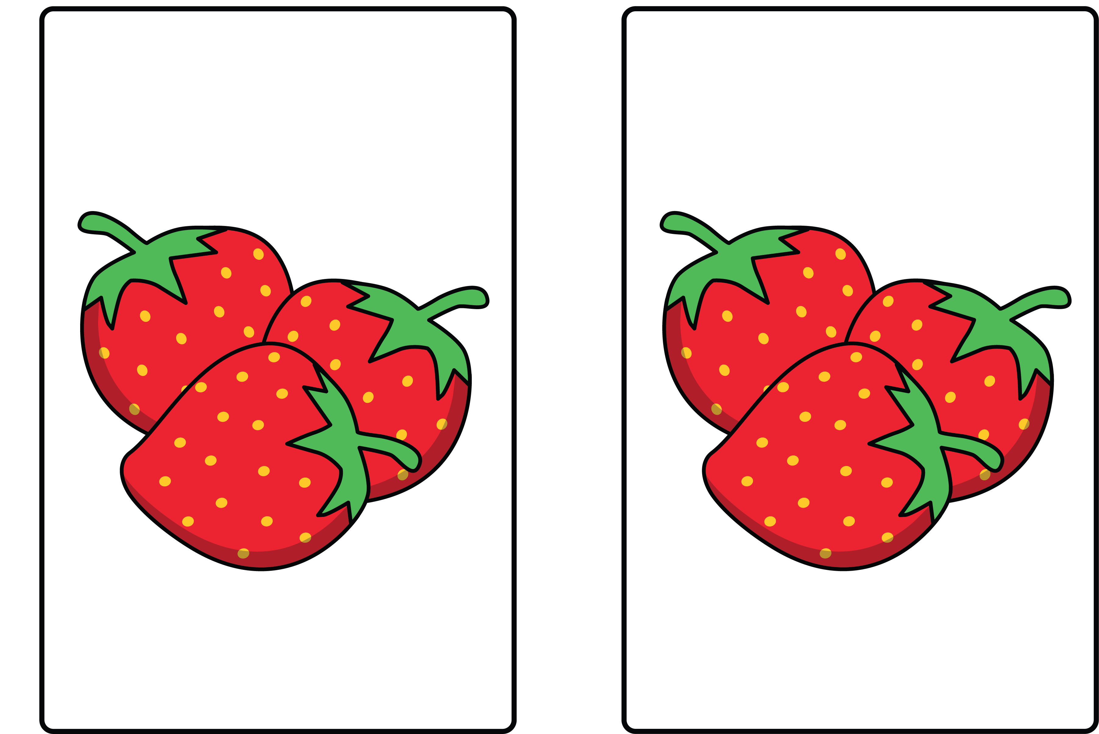

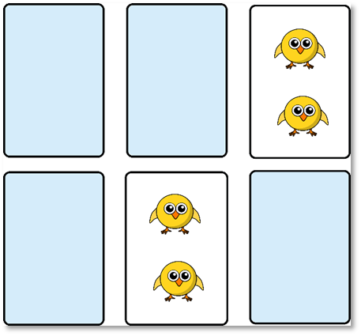


Games

Slide 19
How can you help at home?

Slide 20
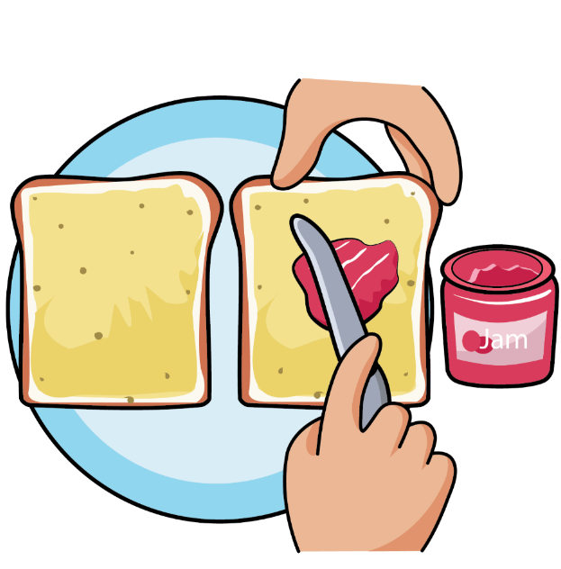
Set the table, does each person have a knife, fork, spoon, plate and cup?
Follow basic recipes, how many cups of flour do we need?
Use the terms ‘more than’, ‘fewer than’ and ‘same as’ when comparing different amounts of ingredients and food.
Is the jug full/half full/empty? How many cups can you fill? Do we have enough for everyone?
Preparing and
eating food and drink

Slide 21
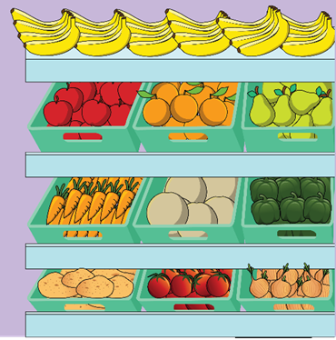
How many of each item do we need to buy?
Which item weighs the most/least?
Sort and categorise the shopping into different bags.
How can we fit the bags in the car? Why should we put the heaviest on the bottom?
Encourage children to spot numerals when walking around the shops.
Going to the shop

Slide 22
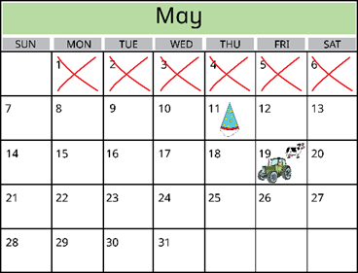
Talk about key events that are happening during the day, week and month.
Count down how many days/sleeps until a key event, such as a birthday.
Notice and talk about the changes that occur during the different seasons.
While getting dressed, talk about the order in which we put on our clothes.
Daily routines

Slide 23
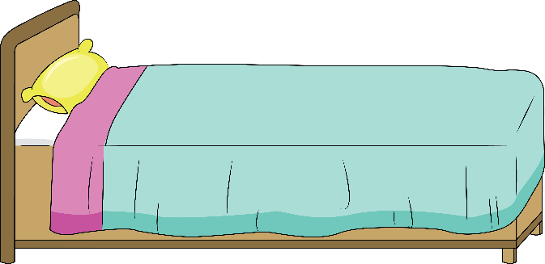
Count the steps as children go upstairs.
Measure the bubble bath into the water – how many spoons/squeezes do we need?
Find matching pyjamas – choose the correct top and bottoms to make a set.
Talk through the order of brushing our teeth – wet toothbrush, add toothpaste etc.
Time how long it takes to brush our teeth.
Bedtime routine

Slide 24
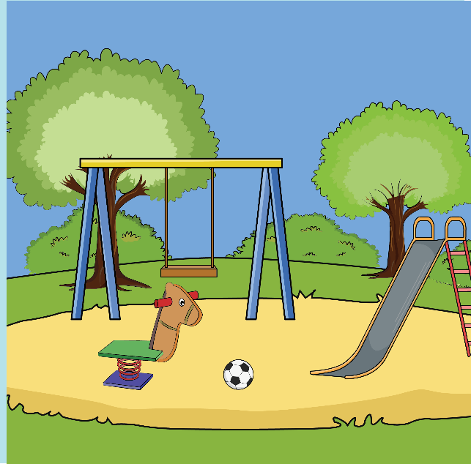
Look for and talk about different shapes and patterns in the natural environment.
Subitise or count the flowers and plants children can see.
Count the times you go down the slide or turn on the roundabout.
Who is swinging the highest on the swing?
At the park

Slide 25
White Rose and EEF
Reception Maths Jigsaw Trial

Slide 26

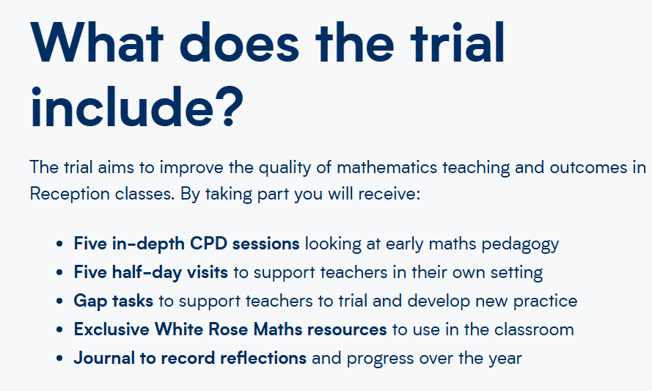
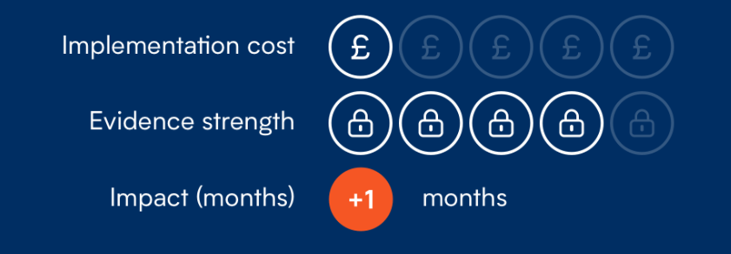


Slide 27

School will be giving out copies of the ‘Parents and carers privacy notice’.
This gives you all the information about the trial and how your child’s data will be used.

Slide 28
Any questions?

